Slide 1

STUDENT CREDENTIALS
Abhinav Kumar
Enrollment / Roll No.
Program
25SCS1003003612
B.Tech (CSE)
YUVALTERN INTERNSHIP · E-GOVERNANCE & DIGITAL SERVICES
Cyber Security Analyst
An 8-Week Professional Internship Presentation Report
INTERNSHIP DURATION
HOST ORGANIZATION
8 Weeks · Completed August 2026
Yuvaltern
Cyber Security Analyst – E-Governance & Digital Services

Slide 2


Student & Internship Details
Candidate Details
Internship Profile
Student Name: Abhinav Kumar
Organization: Yuvaltern
Roll / Enrollment No.: 25SCS1003003612
Internship Role: Cyber Security Analyst – E-Governance & Digital Services
Program: B.Tech – Computer Science & Engineering
Duration: 8 Weeks
College: IILM University, Greater Noida, U.P.
Certificate Date: August 27, 2026
Abhinav Kumar | Yuvaltern Internship Report
2

Slide 3




Organization Profile: Yuvaltern
Yuvaltern (branded as Yuva Intern) is a skill-development and internship platform, operating in association with NSDC, focused on giving students practical, industry-aligned learning experience across digital and emerging domains.
Cybersecurity & Digital Focus: Internship track centered on cybersecurity for e-governance platforms and digital services.
NSDC Collaboration: Operates under the Yuva Intern brand in association with NSDC, supporting skill development for students.
Yuvaltern.com
Founder: Kounal Gupta
Registered Offices: Presence across Noida (Uttar Pradesh), Gurugram (Haryana), and New Delhi.
Cybersecurity
E-Governance
Digital Services
Skill Development
Abhinav Kumar | Yuvaltern Internship Report
3

Slide 4



Internship Objectives
Cybersecurity Foundations
Threat & Risk Awareness
E-Governance & Digital Security
Professional & Analytical Growth
Understand practical cybersecurity concepts and core principles of information security.
Develop awareness of common cyber threats, security risks, and vulnerability concepts.
Understand how cybersecurity protects digital services and e-governance platforms.
Build analytical, problem-solving, and professional communication abilities.
Abhinav Kumar | Yuvaltern Internship Report
4

Slide 5


Internship Role & Responsibilities
Cybersecurity Fundamentals
Risk & Threat Awareness
E-Governance & Digital Security
Documentation & Analysis
Building working knowledge of core cybersecurity concepts, principles, and best practices.
Developing awareness of security risks, common cyber threats, and basic vulnerability concepts.
Understanding e-governance security concepts and digital-service security awareness.
Applying analytical problem-solving, documentation, and reporting in a professional setting.
Note: Role scope was analyst-level awareness, analysis, and documentation work — not penetration testing, ethical hacking, or SOC operations.
Abhinav Kumar | Yuvaltern Internship Report
5

Slide 6



Work & Learning Experience
Cybersecurity
E-Governance
Digital Services
Understanding cybersecurity concepts and security awareness.
Understanding the importance of security in digital governance.
Understanding the role of cybersecurity in protecting digital services.
Analytical Thinking
Professional Environment
Practical Learning
Developing the ability to approach security-related problems systematically.
Learning teamwork, communication, discipline, and professional conduct.
Connecting academic knowledge with an industry-oriented environment.
Abhinav Kumar | Yuvaltern Internship Report
6

Slide 7

Internship Experience & Key Contributions
Dedication: Demonstrated consistent dedication throughout the internship.
Professionalism: Maintained a professional approach toward assigned responsibilities.
Learning & Growth: Displayed a strong willingness to learn and develop.
Team Contribution: Contributed positively to the internship/team environment.
Integrity: Maintained integrity and responsible professional conduct.
Commitment: Demonstrated commitment throughout the program.
Based on the certificate issued by Yuvaltern, Date of Issue: August 27, 2026.
Abhinav Kumar | Yuvaltern Internship Report
7

Slide 8
8-Week Curriculum Timeline
Week 1
Week 3
Week 5
Week 7
Orientation & Introduction
Threats & Security Risks
Security Analysis
Consolidation & Development
Org onboarding & domain intro
Risk & vulnerability awareness
Analytical approach to security
Reviewing & strengthening skills
Week 2
Week 4
Week 6
Week 8
Cybersecurity Fundamentals
E-Governance Security
Practical & Professional Learning
Completion & Reflection
Core concepts & threat awareness
Securing digital services
Documentation & collaboration
Wrap-up & professional development
Abhinav Kumar | Yuvaltern Internship Report
8

Slide 9







Learning Journey
Orientation
Cybersecurity Fundamentals
Threat & Risk Awareness
E-Governance Security
Org & role introduction
Core security concepts
Identifying vulnerabilities
Protecting govt digital services
Internship Completion
Professional Skills
Security Analysis
Digital Services Security
Reflection & wrap-up
Communication & teamwork
Applying analytical thinking
Securing online platforms
Abhinav Kumar | Yuvaltern Internship Report
9

Slide 10
Key Skills Demonstrated & Developed
Technical / Domain Skills
Professional Skills
Cybersecurity Fundamentals
Analytical Thinking
Problem Solving
Cyber Threat Awareness
Security Risk Awareness
Communication
Teamwork
Professionalism
Vulnerability Awareness
Security Analysis
Adaptability
Willingness to Learn
E-Governance Security
Digital Services Security
Integrity
Commitment
Abhinav Kumar | Yuvaltern Internship Report
10

Slide 11
Certificate Verification / Official Details
Verification Metric
Official Certificate Details
Student Name
Abhinav Kumar
Internship Role
Cyber Security Analyst – E-Governance & Digital Services
Issuing Organization
Yuvaltern (Yuva Intern, in association with NSDC)
Certificate Type
Certificate of Experience
Internship Duration
8 Weeks
Date of Issue
August 27, 2026
Founder / Signatory
Kounal Gupta — Founder, YuvaIntern.com
Registered Offices
Noida (U.P.) · Gurugram (Haryana) · New Delhi
Branding shown on certificate: Yuva Intern · NSDC (Re-Imagine Future)
Abhinav Kumar | Yuvaltern Internship Report
11

Slide 12
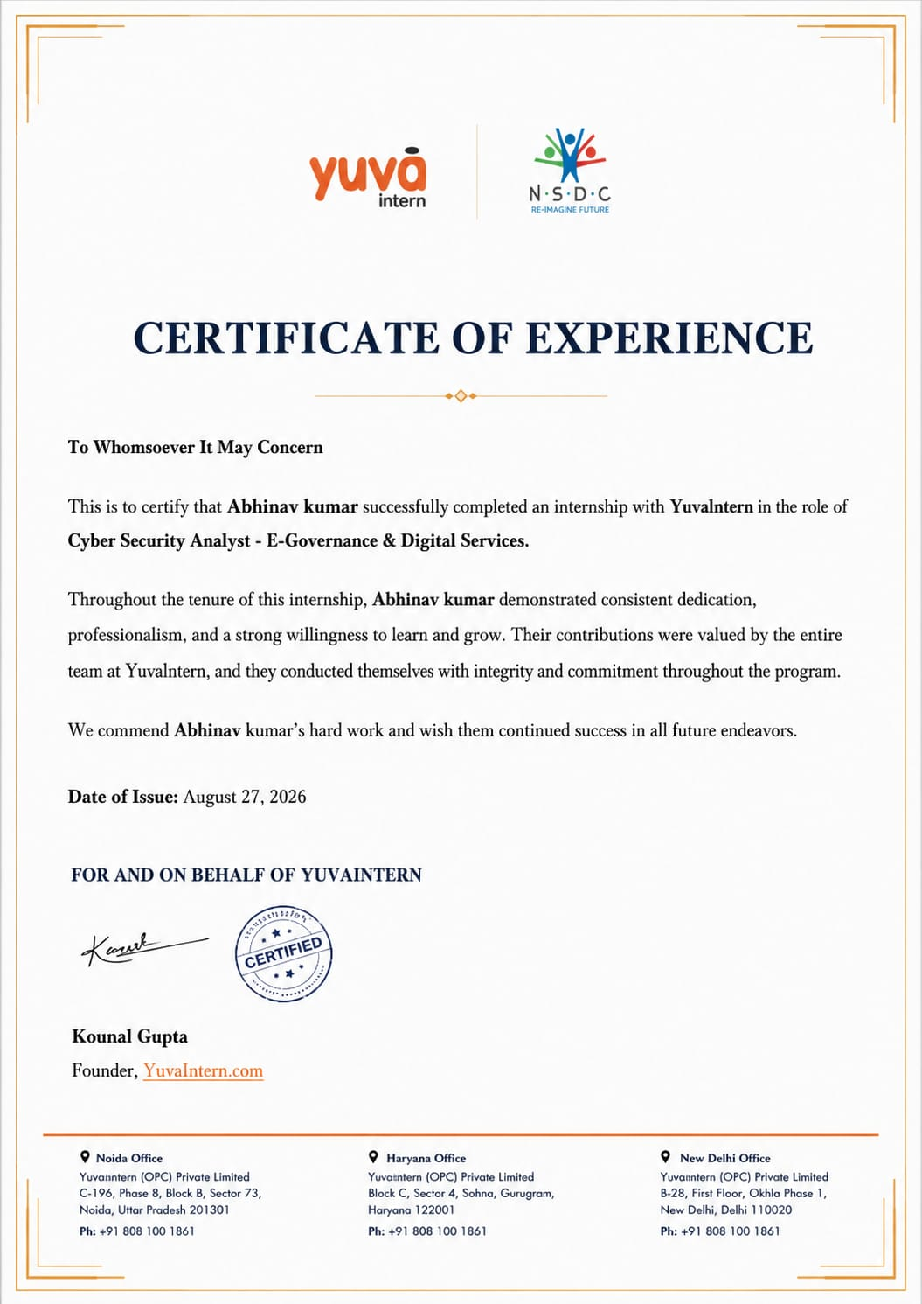
Certificate of Experience
Abhinav Kumar | Yuvaltern Internship Report
12

Slide 13
Thank You!
Abhinav Kumar
Cyber Security Analyst – E-Governance & Digital Services
Roll No: 25SCS1003003612
Yuvaltern · IILM University, Greater Noida, U.P.

